Slide 1
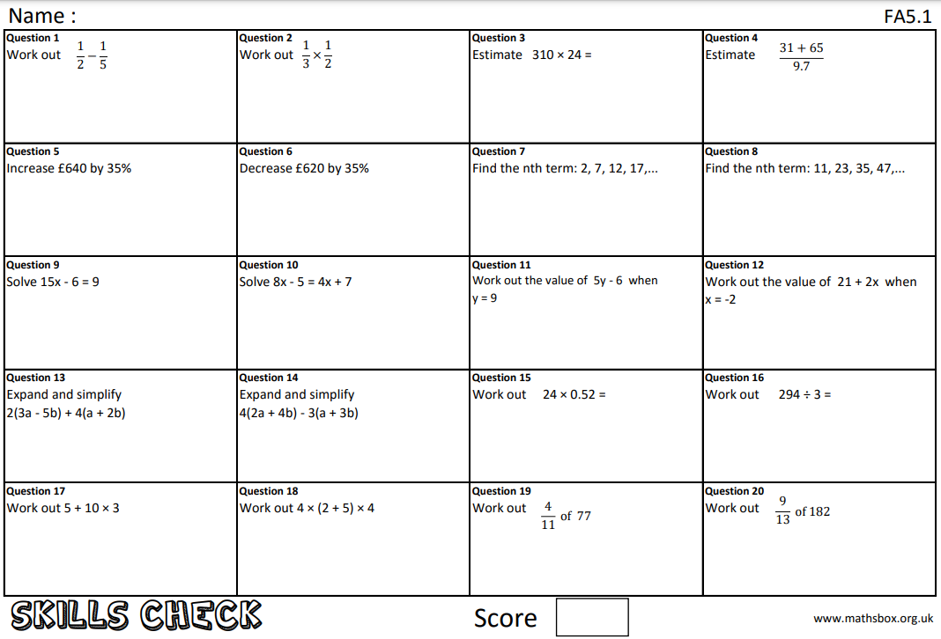
Question 21
What does ‘commutative’ mean?

Slide 2
Due date | Thursday 22nd April 2021
Student number
Name
Year 10
Class 10r3
Homework
Knowledge Check
Homework Sheet FA5.1

Slide 3
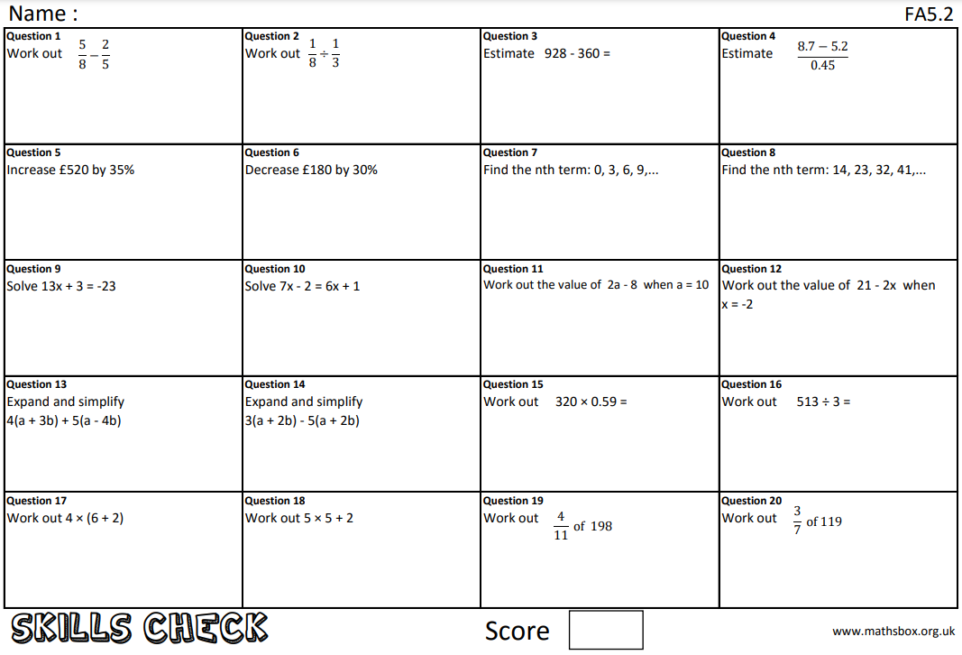
Question 21
What does ‘index’ mean

Slide 4
Due date | Thursday 29th April 2021
Student number
Name
Year 10
Class 10r3
Homework
Knowledge Check
Homework Sheet FA5.2

Slide 5
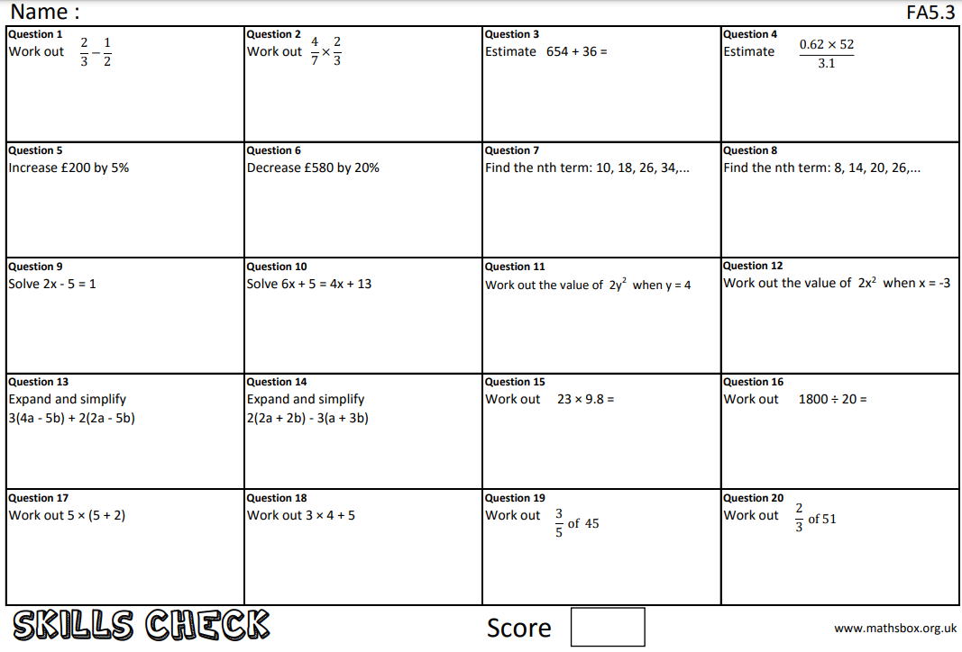
Question 21
What does ‘coefficient’ mean?

Slide 6
Due date | Thursday 6th May 2021
Student number
Name
Year 10
Class 10r3
Homework
Knowledge Check
Homework Sheet FA5.3

Slide 7
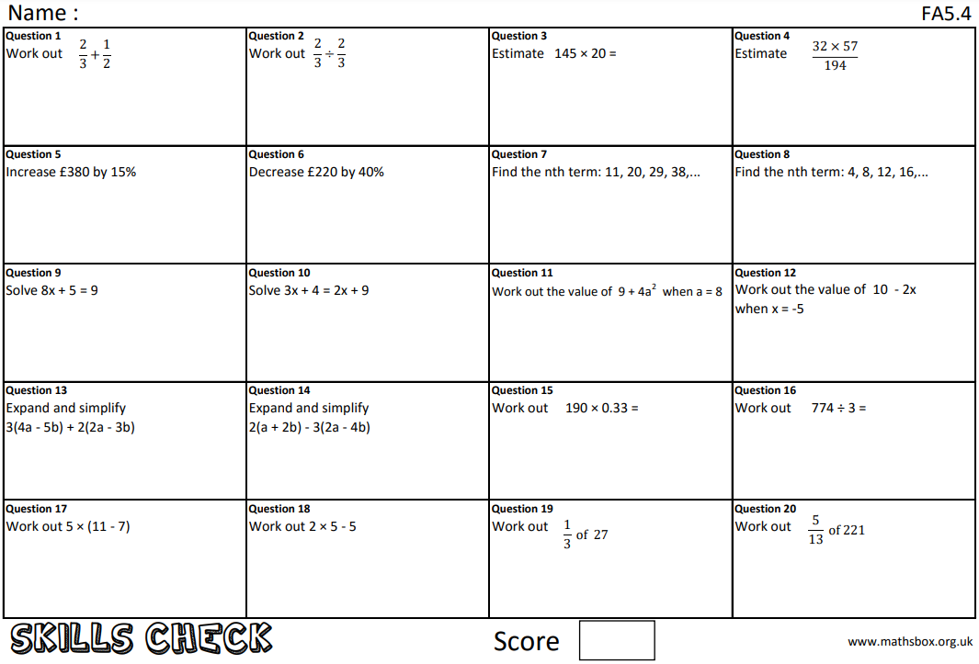
Question 21
What does ‘notation’ mean?

Slide 8
Due date | Thursday 13th May 2021
Student number
Name
Year 10
Class 10r3
Homework
Knowledge Check
Homework Sheet FA5.4

Slide 9
Question 21
What does ‘base number’ mean?

Slide 10
Due date | Thursday 20th May 2021
Student number
Name
Year 10
Class 10r3
Homework
Knowledge Check
Homework Sheet FA5.5

Slide 11
Question 21
What does ‘highest common factor’ mean?

Slide 12
Due date | Thursday 27th May 2021
Student number
Name
Year 10
Class 10r3
Homework
Knowledge Check
Homework Sheet FA5.6

Slide 13
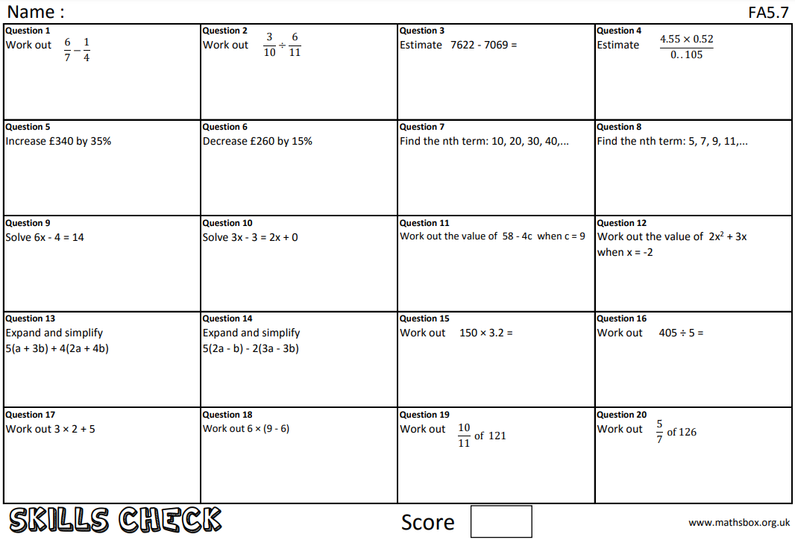
Question 21
What does ‘lowest common multiple’ mean?

Slide 14
Due date | Thursday 10th June 2021
Student number
Name
Year 10
Class 10r3
Homework
Knowledge Check
Homework Sheet FA5.7

