Slide 1
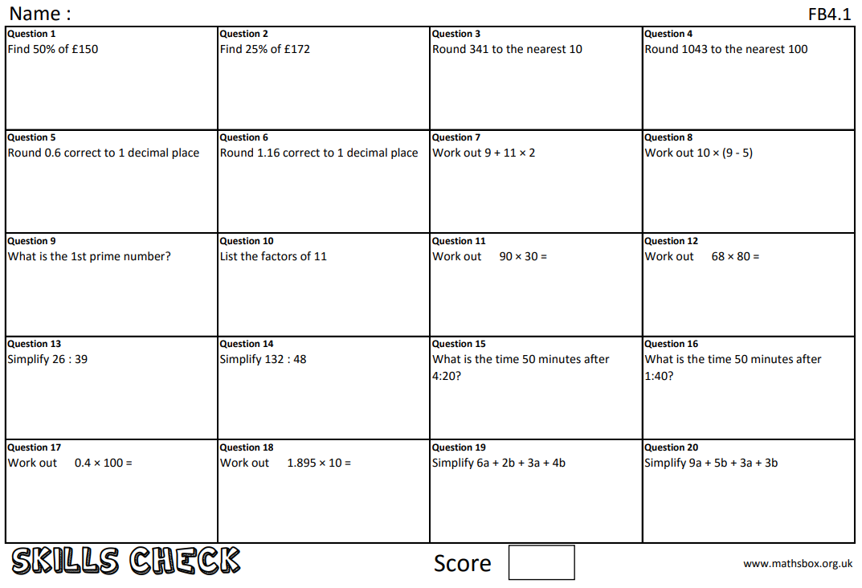
Question 21
What does ‘commutative’ mean?

Slide 2
Due date | Thursday 22nd April 2021
Student number
Name
Year 10
B band
Homework
Knowledge Check
Homework Sheet FB4.1

Slide 3
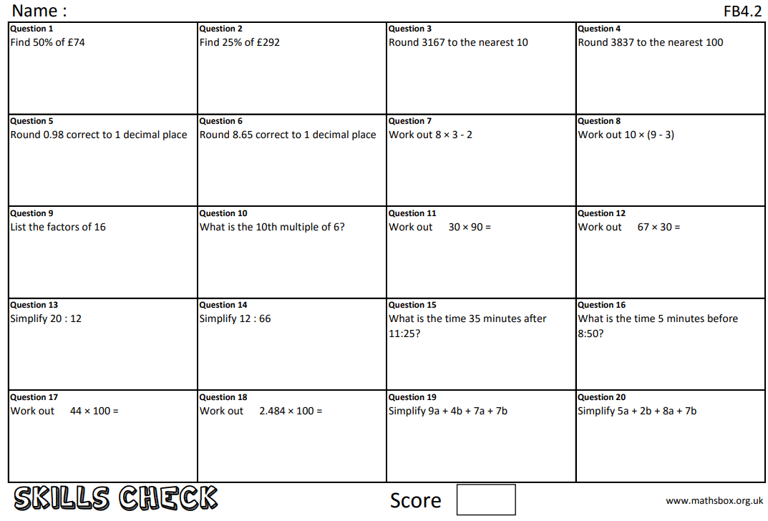
Question 21
What does ‘index’ mean

Slide 4
Due date | Thursday 29th April 2021
Student number
Name
Year 10
B band
Homework
Knowledge Check
Homework Sheet FB4.2

Slide 5
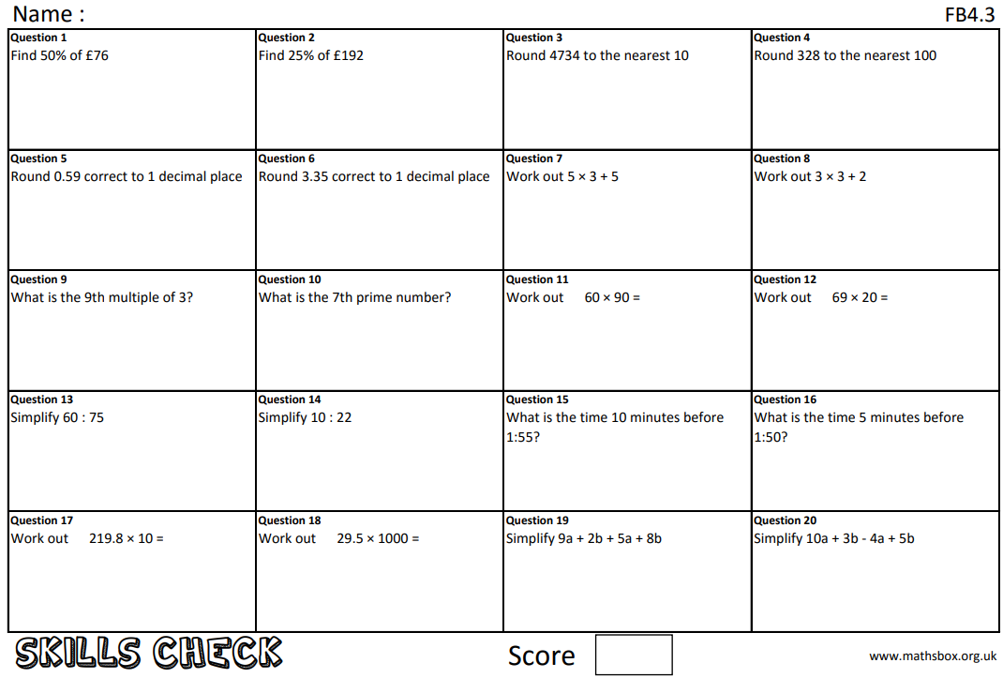
Question 21
What does ‘coefficient’ mean?

Slide 6
Due date | Thursday 6th May 2021
Student number
Name
Year 10
B band
Homework
Knowledge Check
Homework Sheet FB4.3

Slide 7
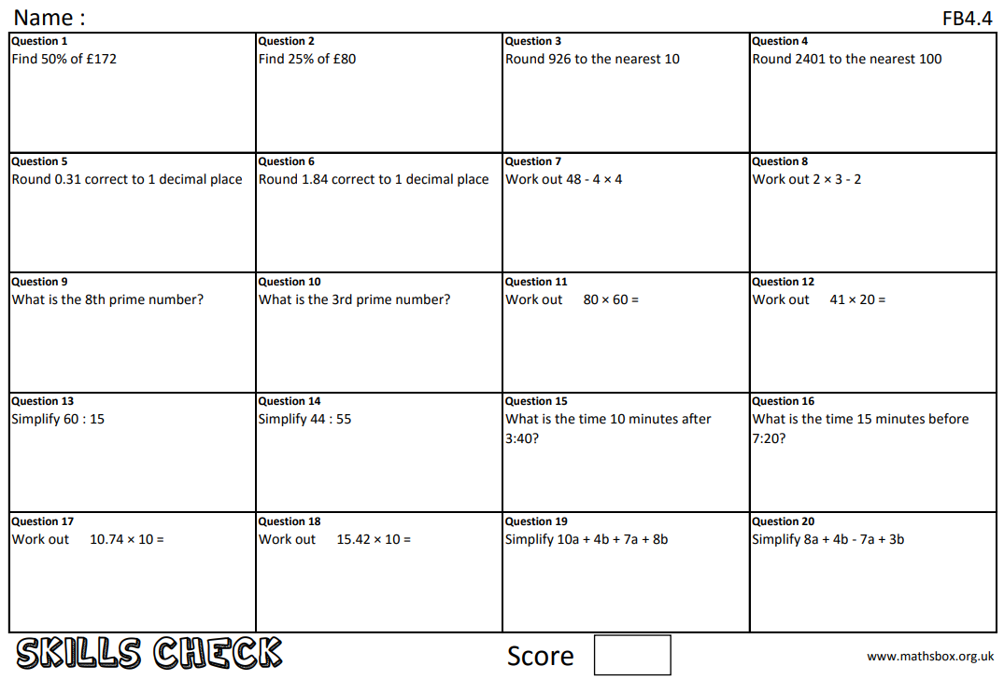
Question 21
What does ‘notation’ mean?

Slide 8
Due date | Thursday 13th May 2021
Student number
Name
Year 10
B band
Homework
Knowledge Check
Homework Sheet FB4.4

Slide 9
Question 21
What does ‘base number’ mean?

Slide 10
Due date | Thursday 20th May 2021
Student number
Name
Year 10
B band
Homework
Knowledge Check
Homework Sheet FB4.5

Slide 11
Question 21
What does ‘highest common factor’ mean?

Slide 12
Due date | Thursday 27th May 2021
Student number
Name
Year 10
B band
Homework
Knowledge Check
Homework Sheet FB4.6

Slide 13
Question 21
What does ‘lowest common multiple’ mean?

Slide 14
Due date | Thursday 10th June 2021
Student number
Name
Year 10
B band
Homework
Knowledge Check
Homework Sheet FB4.7

