Slide 1
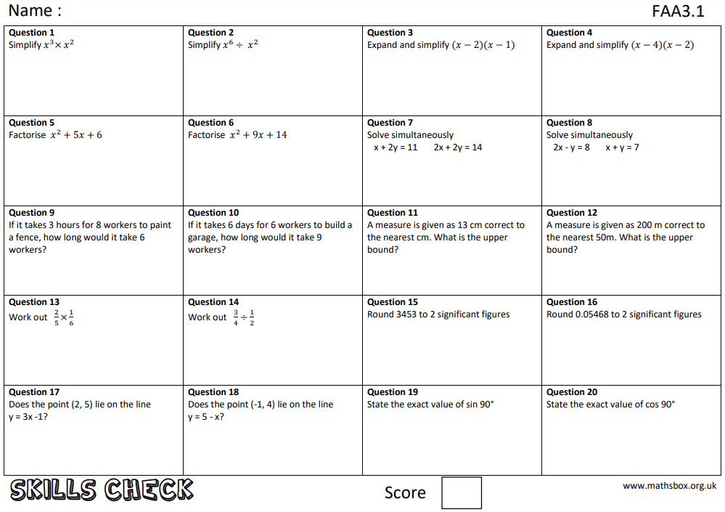
Question 21
What is an ‘arc’?

Slide 2
Due date | Thursday 22nd April 2021
Student number
Name
Year 11
Class 11r2
Homework
Knowledge Check
Homework Sheet FAA3.1

Slide 3
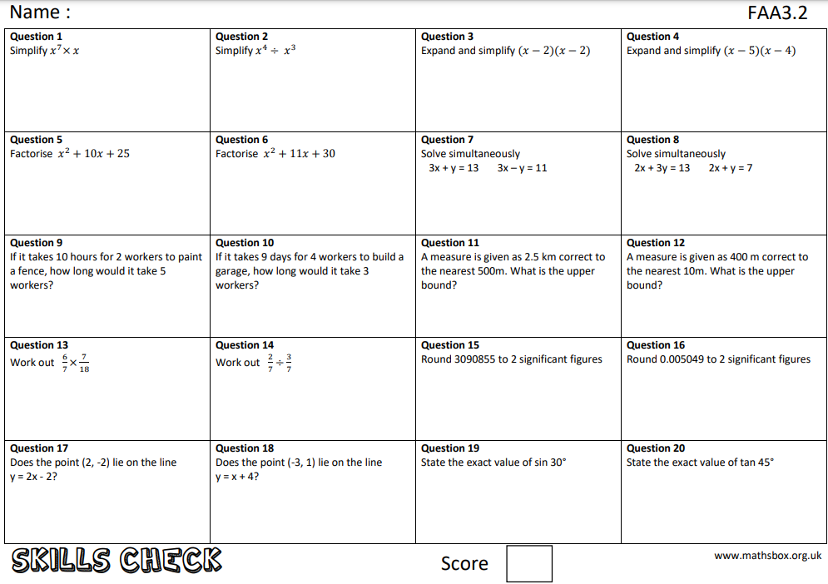
Question 21
What is a ‘sector’?

Slide 4
Due date | Thursday 29th April 2021
Student number
Name
Year 11
Class 11r2
Homework
Knowledge Check
Homework Sheet FAA3.2

Slide 5
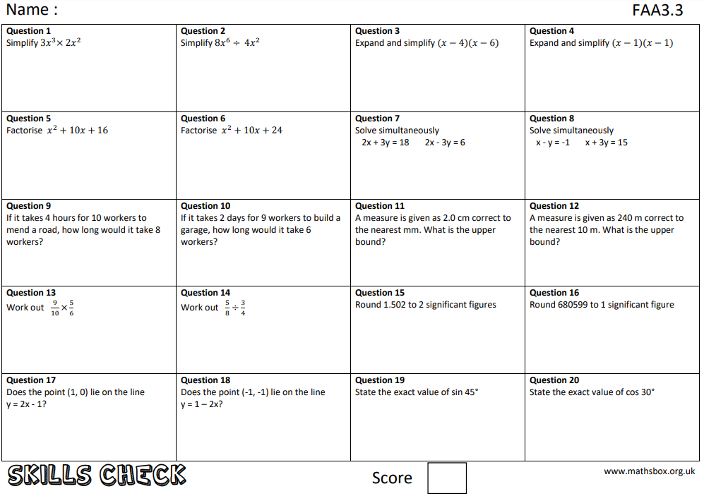
Question 21
What is an ‘alternate angle’?

Slide 6
Due date | Thursday 6th May 2021
Student number
Name
Year 11
Class 11r2
Homework
Knowledge Check
Homework Sheet FAA3.3

Slide 7
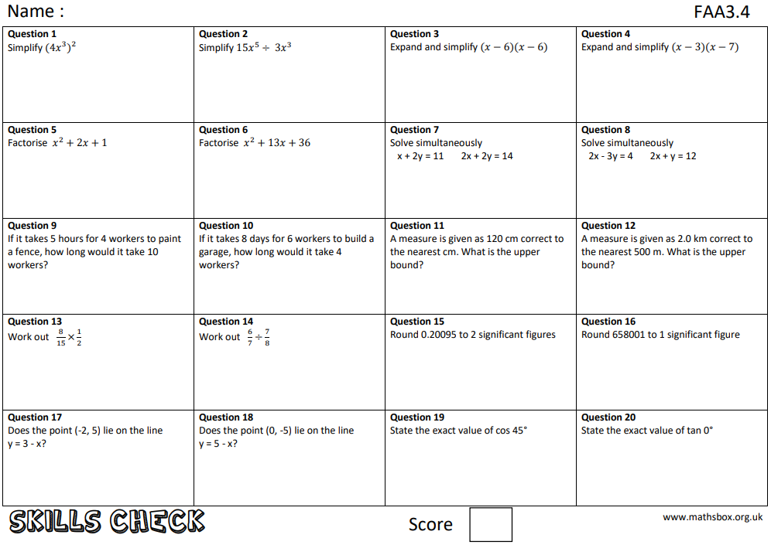
Question 21
What does ’gradient’ mean?

Slide 8
Due date | Thursday 13th May 2021
Student number
Name
Year 11
Class 11r2
Homework
Knowledge Check
Homework Sheet FAA3.4

Slide 9
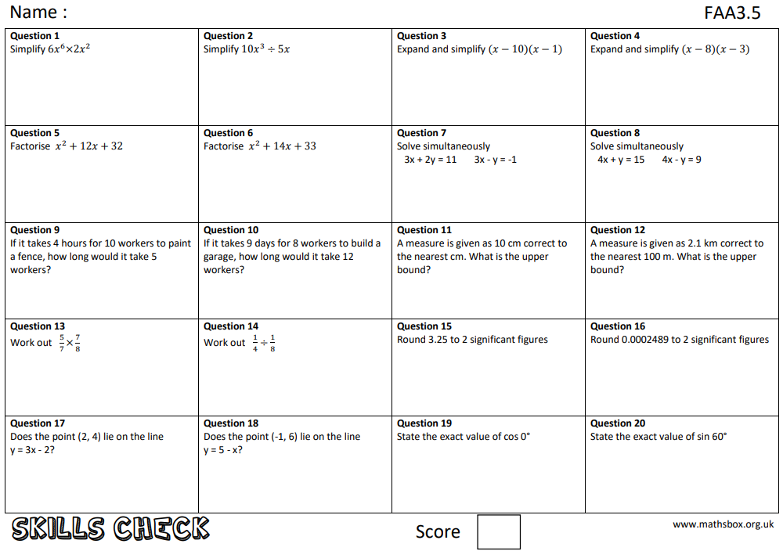
Question 21
What does ‘root’ mean?

Slide 10
Due date | Thursday 20th May 2021
Student number
Name
Year 11
Class 11r2
Homework
Knowledge Check
Homework Sheet FAA3.5

Slide 11
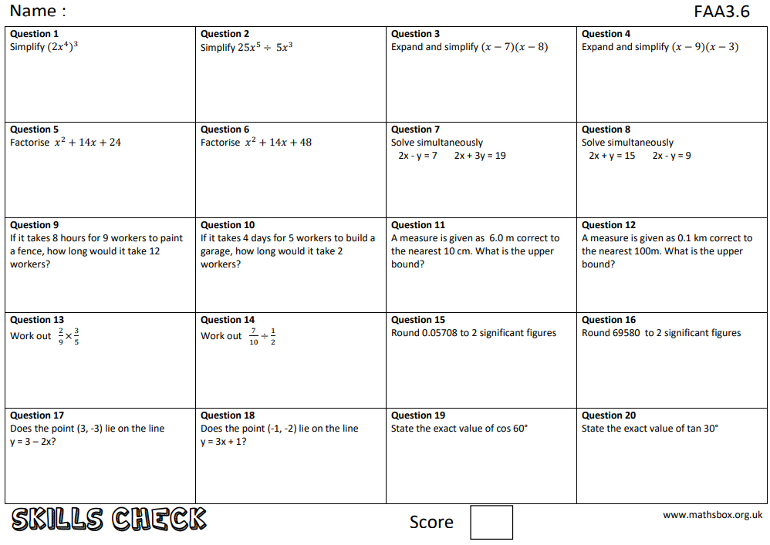
Question 21
Give an example of a terminating decimal

Slide 12
Due date | Thursday 27th May 2021
Student number
Name
Year 11
Class 11r2
Homework
Knowledge Check
Homework Sheet FAA3.6

