Slide 1
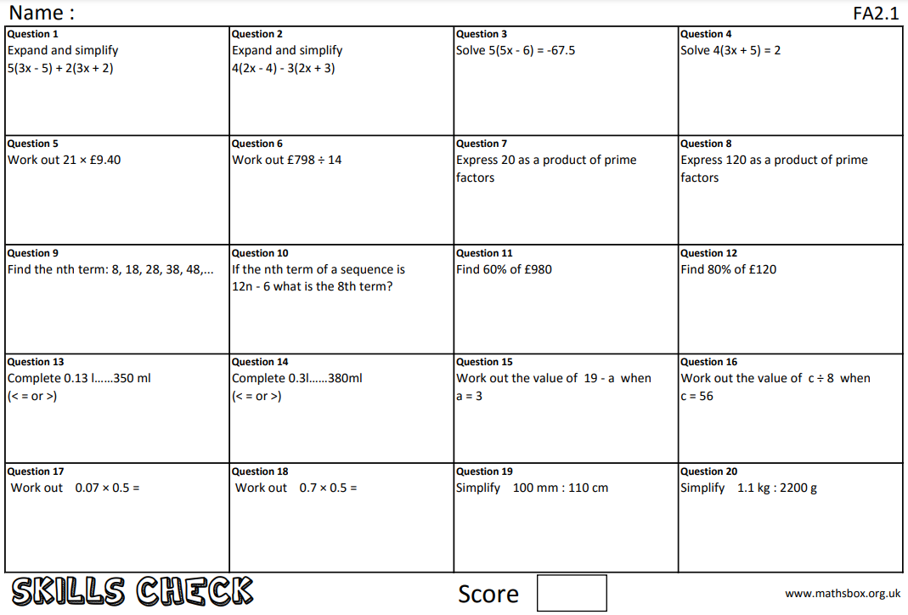
Question 21
What does ‘commutative’ mean?

Slide 2
Due date | Thursday 22nd April 2021
Student number
Name
Year 11
Class 11b2
Homework
Knowledge Check
Homework Sheet FA2.1

Slide 3
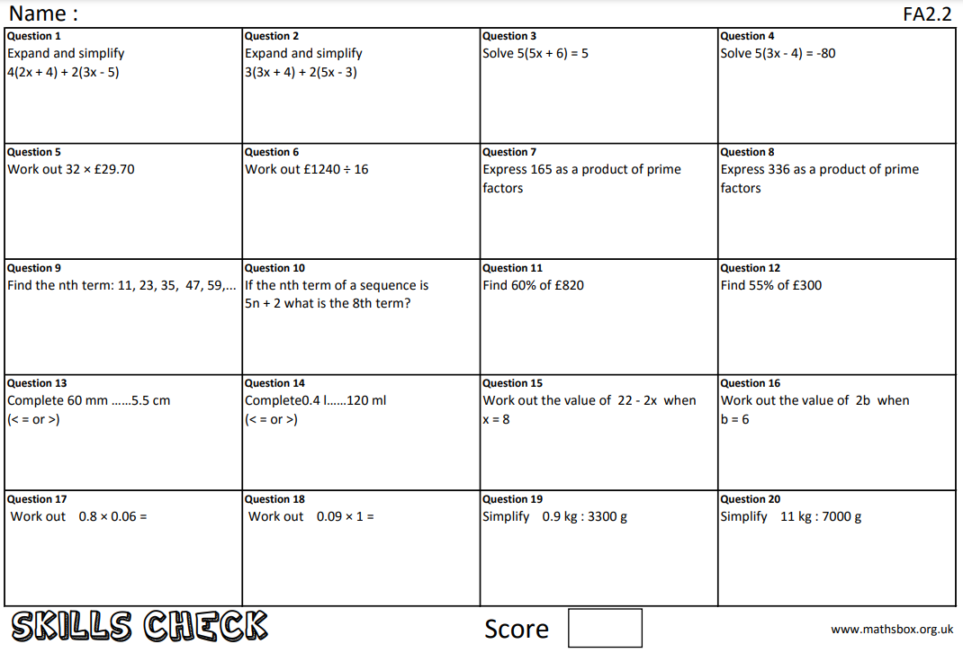
Question 21
What does ‘index’ mean

Slide 4
Due date | Thursday 29th April 2021
Student number
Name
Year 11
Class 11b2
Homework
Knowledge Check
Homework Sheet FA2.2

Slide 5
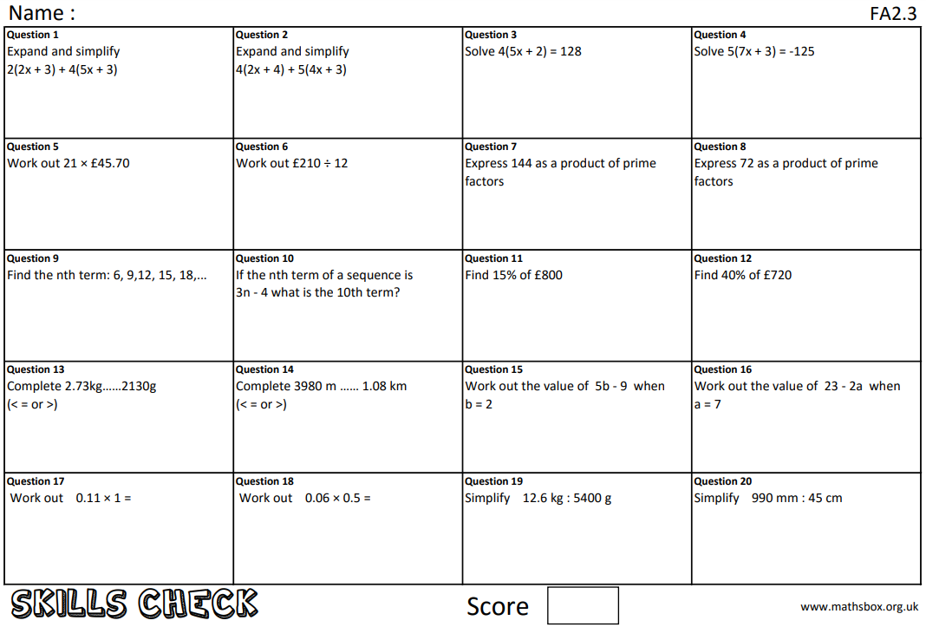
Question 21
What does ‘coefficient’ mean?

Slide 6
Due date | Thursday 6th May 2021
Student number
Name
Year 11
Class 11b2
Homework
Knowledge Check
Homework Sheet FA2.3

Slide 7
Question 21
What does ‘notation’ mean?

Slide 8
Due date | Thursday 13th May 2021
Student number
Name
Year 11
Class 11b2
Homework
Knowledge Check
Homework Sheet FA2.4

Slide 9
Question 21
What does ‘base number’ mean?

Slide 10
Due date | Thursday 20th May 2021
Student number
Name
Year 11
Class 11b2
Homework
Knowledge Check
Homework Sheet FA2.5

Slide 11
Question 21
What does ‘highest common factor’ mean?

Slide 12
Due date | Thursday 27th May 2021
Student number
Name
Year 11
Class 11b2
Homework
Knowledge Check
Homework Sheet FA2.6

